Slide 1
Data Mining-Techniques Delivered By: Mr. SACHIN J PUKALE Lecturer Department of Information Technology Government Polytechnic Nagpur.

Slide 2
Decision Tree
A decision tree is a classifier in the form of a tree structure with two types of nodes:
Decision node: Specifies a choice or test of some attribute, with one branch for each outcome
Leaf node: Indicates classification of an example

Slide 3
Decision Tree Example 1 Whether to approve a loan
Employed?
No
Yes
Credit Score?
Income?
High
Low
High
Low
Approve
Reject
Approve
Reject

Slide 4
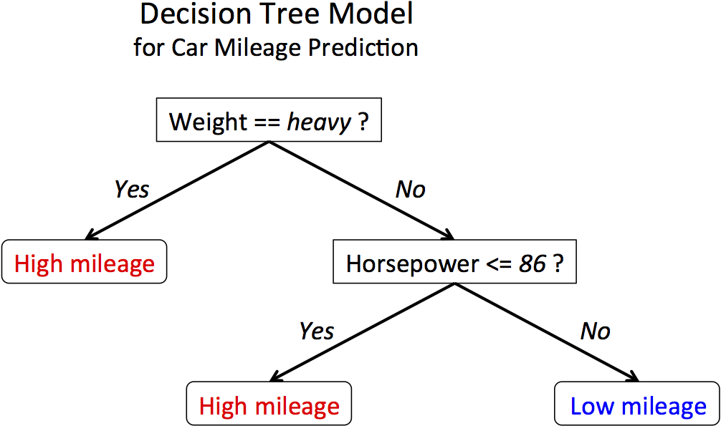

Decision Tree Example

Slide 5
ISSUES
Given some training examples, what decision tree should be generated?
One proposal: prefer the smallest tree that is consistent with the data (Bias)
the tree with the least depth?
the tree with the fewest nodes?
Possible method:
search the space of decision trees for the smallest decision tree that fits the data

Slide 6
Example Data
Training Examples:
 | Action | Author | Thread | Length | Where
e1 | skips | known | new | long | Home
e2 | reads | unknown | new | short | Work
e3 | skips | unknown | old | long | Work
e4 | skips | known | old | long | home
e5 | reads | known | new | short | home
e6 | skips | known | old | long | work
New Examples:
e7 | ??? | known | new | short | work
e8 | ??? | unknown | new | short | work

Slide 7
POSSIBLE SPLITS
length
skips 9
reads 9
long
short
thread
skips 9
reads 9
Skips 2
Reads 9
Skips 7
Reads 0
new
old
Skips 6
Reads 2
Skips 3
Reads 7

Slide 8
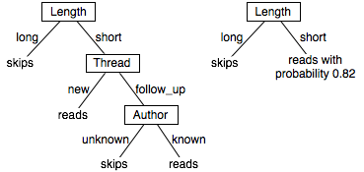
Two Example DTs

Slide 9
Decision Tree for PlayTennis
Attributes and their values:
Outlook: Sunny, Overcast, Rain
Humidity: High, Normal
Wind: Strong, Weak
Temperature: Hot, Mild, Cool
Target concept - Play Tennis: Yes, No

Slide 10
Decision Tree for Play Tennis
Outlook
Sunny
Overcast
Rain
Humidity
Yes
Wind
High
Normal
Strong
Weak
No
Yes
No
Yes

Slide 11
Decision Tree for Play Tennis
Outlook
Sunny
Overcast
Rain
Humidity
Each internal node tests an attribute
High
Normal
Each branch corresponds to an
attribute value node
Yes
Each leaf node assigns a classification

Slide 12
Decision Tree for PlayTennis
Outlook Temperature Humidity Wind PlayTennis
Sunny Hot High Weak ?
Outlook
Sunny
Overcast
Rain
Humidity
Yes
Wind
High
Normal
Strong
Weak
No
Yes
No
Yes

Slide 13
Decision Tree
Decision trees represent disjunctions of conjunctions
Outlook
Sunny
Overcast
Rain
Humidity
Yes
Wind
High
Normal
Strong
Weak
No
Yes
No
Yes
(Outlook=Sunny ∧ Humidity=Normal)
∨ (Outlook=Overcast)
∨ (Outlook=Rain ∧ Wind=Weak)

Slide 14
Searching for a good tree
How should you go about building a decision tree?
The space of decision trees is too big for systematic search.
Stop and
return the a value for the target feature or
a distribution over target feature values
Choose a test (e.g. an input feature) to split on.
For each value of the test, build a subtree for those examples with this value for the test.

Slide 15
Top-Down Induction of Decision Trees ID3
1. Which node to proceed with?
A ← the “best” decision attribute for next node
Assign A as decision attribute for node
For each value of A create new descendant
Sort training examples to leaf node according to the attribute value of the branch
If all training examples are perfectly classified (same value of target attribute) stop, else iterate over new leaf nodes.
2. When to stop?

Slide 16
Choices
When to stop
no more input features
all examples are classified the same
too few examples to make an informative split
Which test to split on
split gives smallest error.
With multi-valued features
split on all values or
split values into half.

Slide 17
Choices
[29+,35-]
A₁=?
A₂=?
[29+,35-]
True
False
True
False
[21+, 5-]
[8+, 30-]
[18+, 33-]
[11+, 2-]

Slide 18
Principled Criterion
Selection of an attribute to test at each node - choosing the most useful attribute for classifying examples.
information gain
measures how well a given attribute separates the training examples according to their target classification
This measure is used to select among the candidate attributes at each step while growing the tree
Gain is measure of how much we can reduce uncertainty (Value lies between 0,1)

Slide 19
Entropy
A measure for
uncertainty
purity
information content
Information theory: optimal length code assigns (− log₂p) bits to message having probability p
S is a sample of training examples
p₊ is the proportion of positive examples in S
p₋ is the proportion of negative examples in S
Entropy of S: average optimal number of bits to encode information about certainty/uncertainty about S
Entropy(S) = p₊(−log₂p₊) + p₋(−log₂p₋) = −p₊log₂p₊− p₋log₂p₋

Slide 20
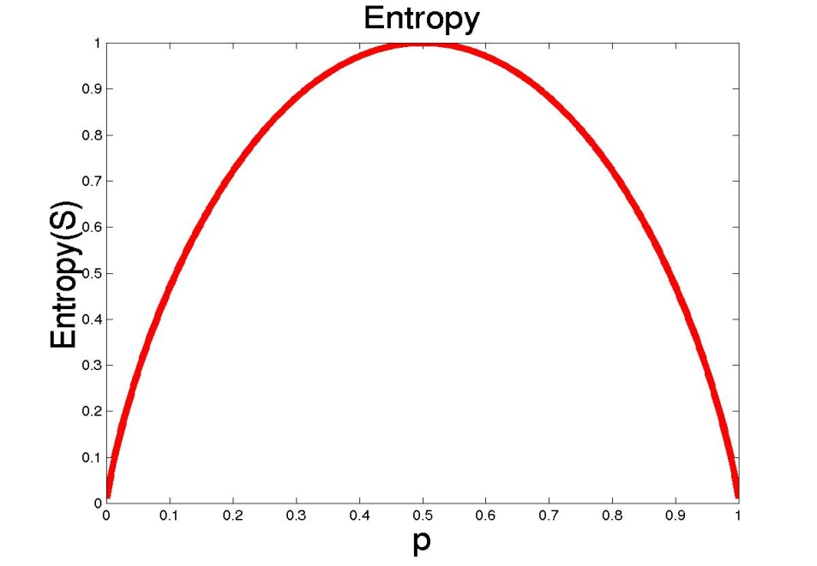
Entropy
The entropy is 0 if the outcome is ``certain”.
The entropy is maximum if we have no knowledge of the system (or any outcome is equally possible).
S is a sample of training examples
p₊ is the proportion of positive examples
p₋ is the proportion of negative examples
Entropy measures the impurity of S
Entropy(S) = −p₊log₂p₊− p₋log₂ p₋

Slide 21
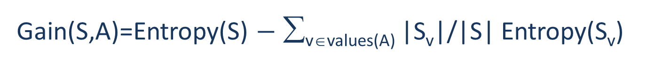
Information Gain
Gain(S,A): expected reduction in entropy due to partitioning S on attribute A
Entropy([29+,35-]) = -29/64 log₂ 29/64 – 35/64 log₂ 35/64
= 0.99
[29+,35-]
A₁=?
A₂=?
[29+,35-]
True
False
True
False
[21+, 5-]
[8+, 30-]
[18+, 33-]
[11+, 2-]

Slide 22
Information Gain
Gain(S,A): expected reduction in entropy due to partitioning S on attribute A
[29+,35-]
A₁=?
A₂=?
[29+,35-]
True
False
True
False
[18+, 33-]
[11+, 2-]
[21+, 5-]
[8+, 30-]

Slide 23
Information Gain
Entropy([18+,33-]) = 0.94
Entropy([8+,30-]) = 0.62
Gain(S,A₂)=Entropy(S)
-51/64*Entropy([18+,33-])
-13/64*Entropy([11+,2-])
=0.12
Entropy([21+,5-]) = 0.71
Entropy([8+,30-]) = 0.74
Gain(S,A₁)=Entropy(S)
-26/64*Entropy([21+,5-])
-38/64*Entropy([8+,30-])
=0.27
[29+,35-]
A₁=?
A₂=?
[29+,35-]
True
False
True
False
[21+, 5-]
[8+, 30-]
[18+, 33-]
[11+, 2-]

Slide 24
Training Examples
Day | Outlook | Temp | Humidity | Wind | Tennis?
D1 | Sunny | Hot | High | Weak | No
D2 | Sunny | Hot | High | Strong | No
D3 | Overcast | Hot | High | Weak | Yes
D4 | Rain | Mild | High | Weak | Yes
D5 | Rain | Cool | Normal | Weak | Yes
D6 | Rain | Cool | Normal | Strong | No
D7 | Overcast | Cool | Normal | Strong | Yes
D8 | Sunny | Mild | High | Weak | No
D9 | Sunny | Cool | Normal | Weak | Yes
D10 | Rain | Mild | Normal | Weak | Yes
D11 | Sunny | Mild | Normal | Strong | Yes
D12 | Overcast | Mild | High | Strong | Yes
D13 | Overcast | Hot | Normal | Weak | Yes
D14 | Rain | Mild | High | Strong | No

Slide 25
Selecting the Next Attribute
S=[9+,5-]
E=0.940
S=[9+,5-]
E=0.940
Humidity
Wind
High
Normal
Weak
Strong
[3+, 4-]
[6+, 1-]
[6+, 2-]
[3+, 3-]
E=0.592
E=0.811
E=0.985
E=1.0
Gain(S,Humidity)
=0.940-(7/14)*0.985
– (7/14)*0.592
=0.151
Gain(S,Wind)
=0.940-(8/14)*0.811
– (6/14)*1.0
=0.048
Humidity provides greater info. gain than Wind, w.r.t target classification.

Slide 26
Selecting the Next Attribute
S=[9+,5-]
E=0.940
Outlook
Sunny
Overcast
Rain
[2+, 3-]
[4+, 0]
[3+, 2-]
E=0.971
E=0.0
E=0.971
Gain(S,Outlook)
=0.940-(5/14)*0.971
-(4/14)*0.0 – (5/14)*0.0971
=0.247

Slide 27
Selecting the Next Attribute
The information gain values for the 4 attributes are:
Gain(S,Outlook) =0.247
Gain(S,Humidity) =0.151
Gain(S,Wind) =0.048
Gain(S,Temperature) =0.029
where S denotes the collection of training examples
Note: 0Log₂0 =0

Slide 28
ID3 Algorithm
[D1,D2,…,D14]
[9+,5-]
Outlook
Sunny
Overcast
Rain
S_{sunny}=[D1,D2,D8,D9,D11]
[2+,3-]
[D3,D7,D12,D13]
[4+,0-]
?
Yes
?
Gain(S_{sunny} , Humidity)=0.970-(3/5)0.0 – 2/5(0.0) = 0.970
Gain(S_{sunny} , Temp.)=0.970-(2/5)0.0 –2/5(1.0)-(1/5)0.0 = 0.570
Gain(S_{sunny} , Wind)=0.970= -(2/5)1.0 – 3/5(0.918) = 0.019
[D4,D5,D6,D10,D14]
[3+,2-]

Slide 29
ID3 Algorithm
Outlook
Sunny
Overcast
Rain
Humidity
Yes
Wind
[D3,D7,D12,D13]
High
Normal
Strong
Weak
No
Yes
No
Yes
[D1,D2]
[D8,D9,D11]
[D6,D14]
[D4,D5,D10]

Slide 30
Selecting the Next Attribute
Outlook
Sunny
Overcast
Rain
Humidity
Yes
Wind
[D3,D7,D12,D13]
High
Normal
Strong
Weak
No
Yes
No
Yes
[D1,D2]
[D8,D9,D11]
[D6,D14]
[D4,D5,D10]

Slide 31
Thank You

